Slide 1
MSA 8389 Directed reading in Analytics – Trip Advisor Project Shreyashi Mukhopadhyay July 31, 2023

Slide 2
Multimodal classification of the Helpfulness of a review using Text and Image data from Tripadvisor.com

Slide 3
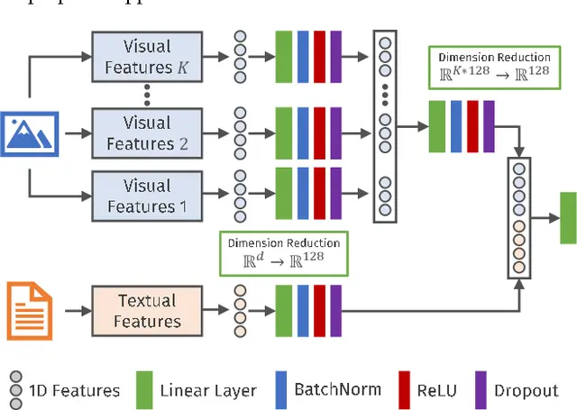
Architecture: Multimodal classification using Text and Image data
Output class

Slide 4

Classification of the Helpfulness of text reviews using LSTMs onTripAdvisor.com

Slide 5

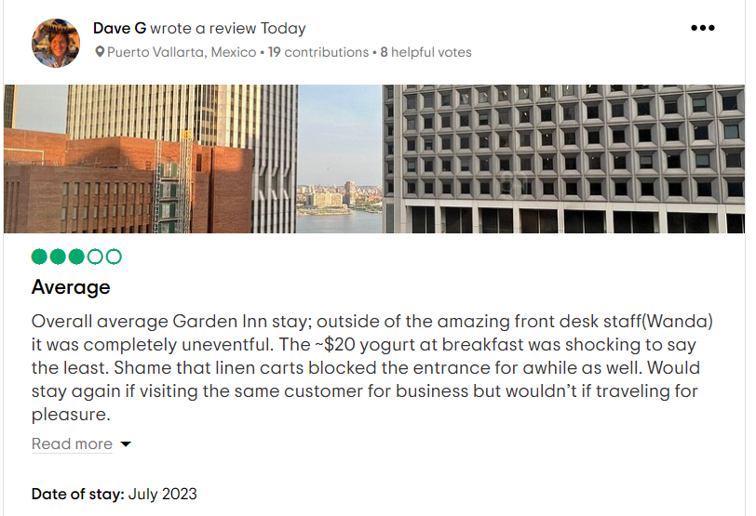



Web scraping text and image reviews from Tripadvisor.com
Image
+
Text
HILTON GARDEN INN NYC FINANCIAL CENTER / MANHATTAN DOWNTOWN $135 ($̶3̶7̶7̶) - Updated 2023 Prices & Hotel Reviews - New York City (tripadvisor.com)

Slide 6
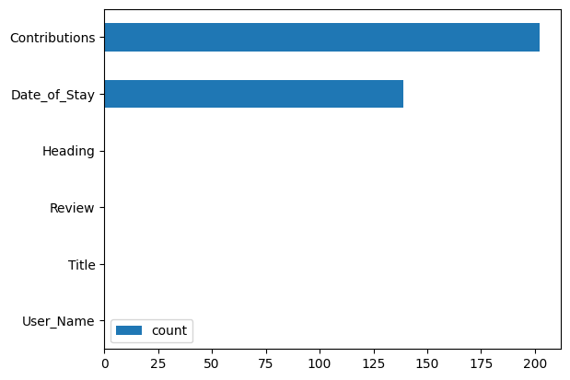
Data Description - TripAdvisor_Text_Reviews.csv
Data has 82386 rows and 6 Columns
# Column Non-Null Count Dtype
0 User_Name 82386 non-null object
1 Contributions 82184 non-null object
2 Title 82386 non-null object
3 Review 82386 non-null object
4 Date_of_Stay 82247 non-null object
5 Heading 82386 non-null object
Null Values
Columns | Null values
Contributions | 202
Date_of_Stay | 139
User_Name | 0
Title | 0
Review | 0
Heading | 0

Slide 7
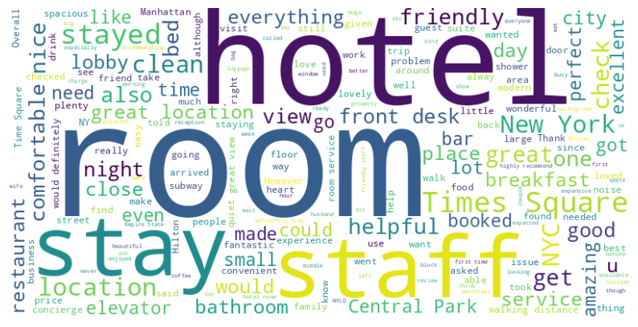
Overall Reviews Sentiment - Positive
Users have used positive and affirmative words with high frequency words Room, Hotel in their reviews like Helpful, Nice, Stay, Comfortable, great, Staff, excellent, nice, amazing, friendly, service, Location, NYC, good, view, close to Times square etc.

Slide 8
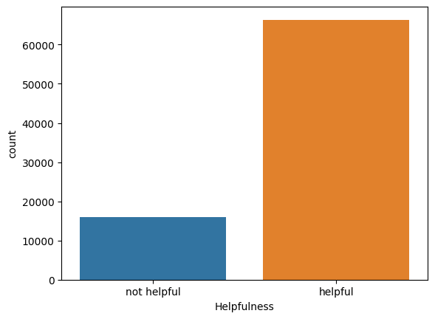
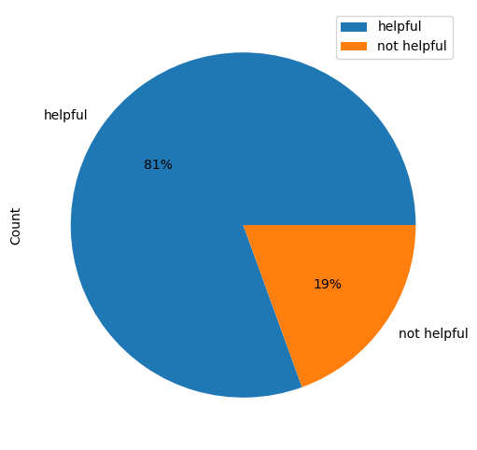
Label the data using Helpfulness of the review
Class Imbalance observed
 | Contributions | Title | Review | Helpfulness
0 | Riyadh, Saudi Arabia;1 contribution | ['Nice'] | Nice experience in the hotel for anyone who would like to stay in NYC. It is near the World Trade Center. I will choose it if I come again to NYC. Also, Special thanks to Mr.Luigi & Mr.An & Ms.Nakita for their kindness and their nice hospitality. | not helpful
1 | Montreal, Canada;8939 contributions;8939;100 helpful votes | ['Nice stay for my return to New York'] | I hadn't been to New York in 22 months (which is really long for me). I decided to stay away from Midtown so picked this hotel in the financial district. The personnel was really nice and helpful. I had few needs and did not require the room clean but they provided me with anything I requested. They were also very helpful with the subway system. Because of Hurricane Henri my flight was cancelled and they were very accommodating with giving me an extra night in the same room. I really enjoyed my stay | Helpful

Slide 9
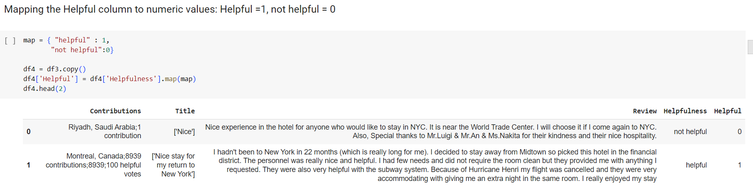
Assigning final labels to the data

Slide 10
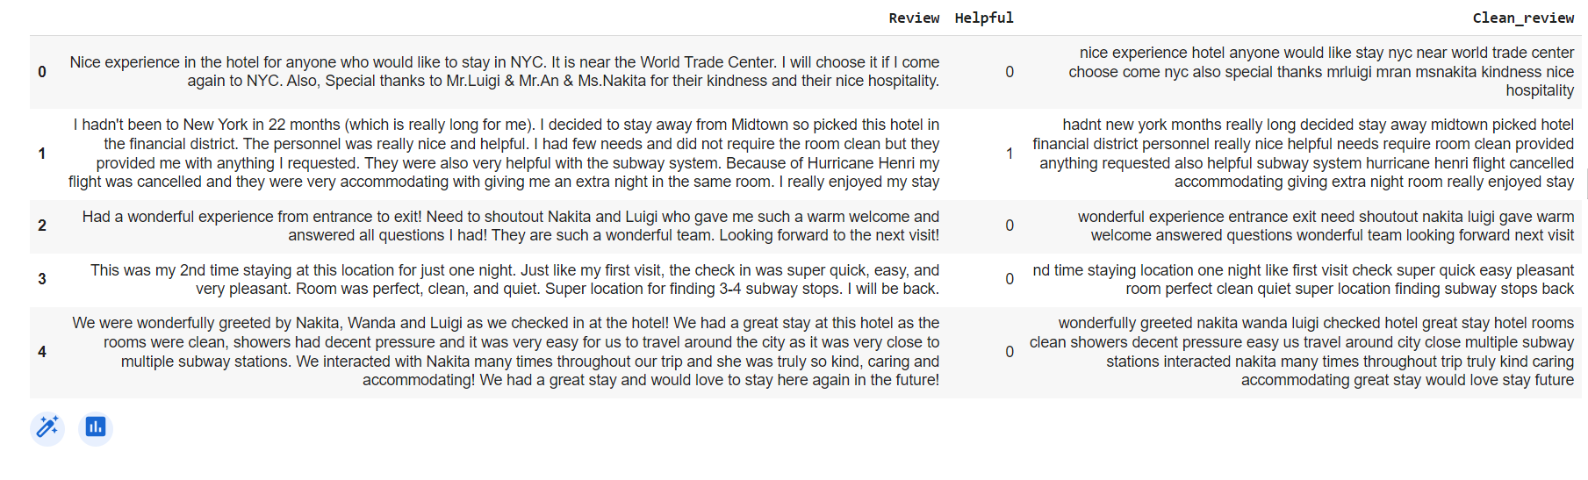
Data Cleaning
Converting text to lower case
Removing punctuations & Numbers
Removing white spaces
Tokenizing the data
Applying stop words
Joining the tokens

Slide 11
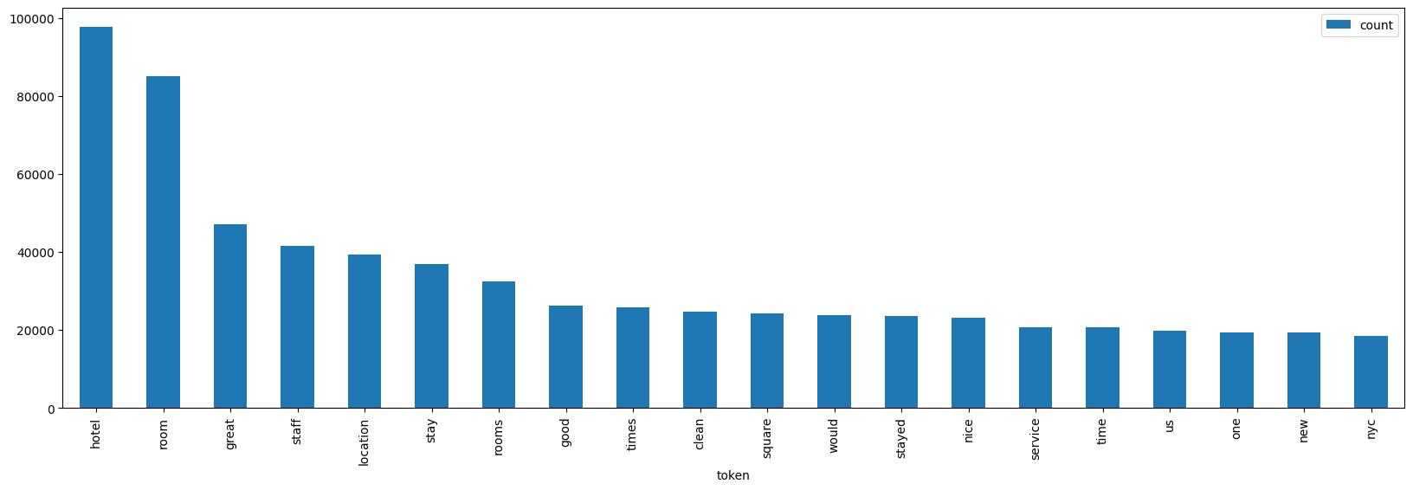
Distribution of top 20-word tokens

Slide 12
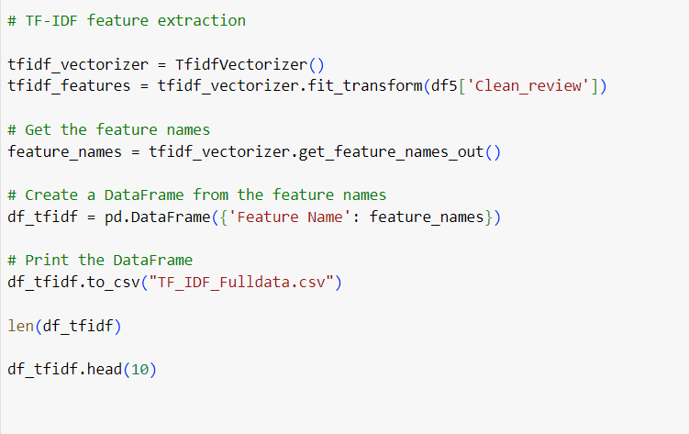
Feature extraction using TFIDF method
Feature Extraction with TF IDF – 58826 features
Feature Name
0 | aa
1 | aaa
2 | aaaaa
3 | aaaaarp
4 | aaaahhhh
5 | aaaamazing
6 | aaahhhuummm
7 | aaargh
8 | aable
9 | aacap

Slide 13
Modelling
Models Fitted
Train Test Split: 80:20
Shape of training tensor: (65908, 50)
Shape of testing tensor: (16478, 50)
Epochs = 10
Batch size = 32
LSTM
GRU
BiLSTM

Slide 14
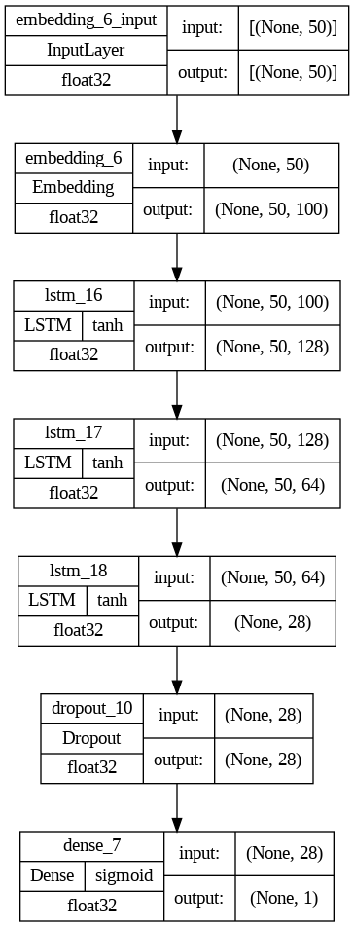
LSTM Model
Model Configuration
Model Performance:
Model | Loss | Accuracy
Lstm_Train | 0.379144 | 0.829596
Lstm_Test | 0.482268 | 0.803131

Slide 15
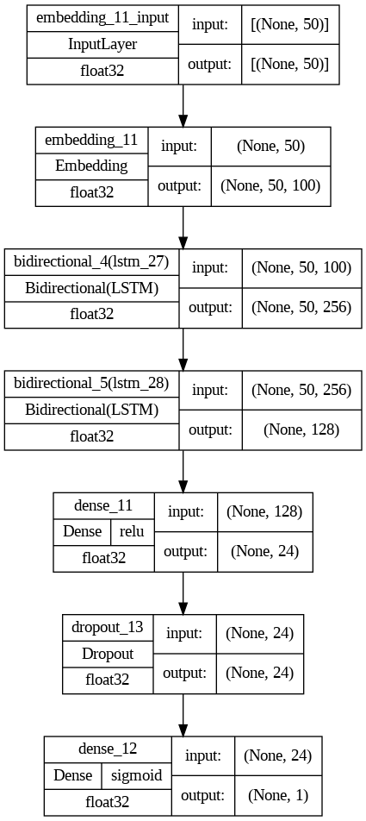
BiLSTM Model
Model Configuration
Model Performance:
Model | Loss | Accuracy
Bilstm_Train | 0.438247 | 0.807474
Bilstm_Test | 0.461621 | 0.797063

Slide 16
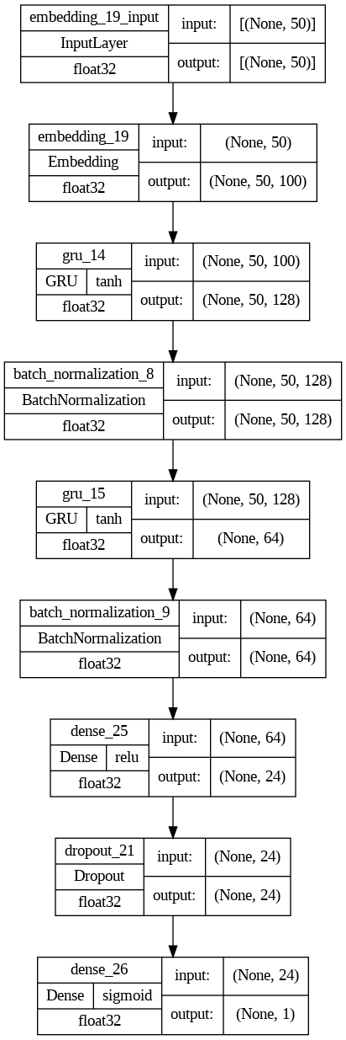
GRU Model
Model Configuration
Model Performance:
Model | Loss | Accuracy
GRU_Train | 0.438247 | 0.807474
GRU_Test | 0.461621 | 0.797063

Slide 17
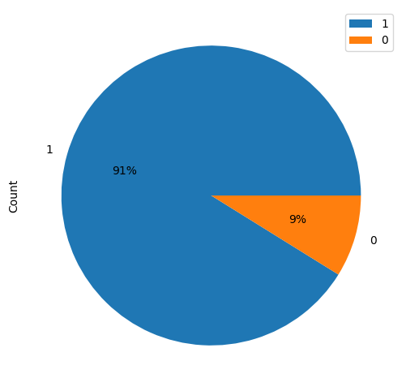
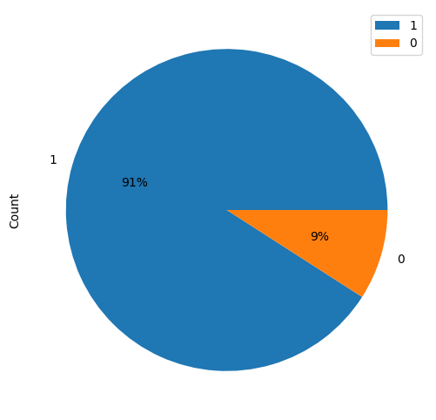
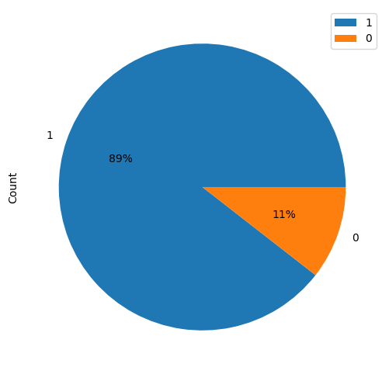
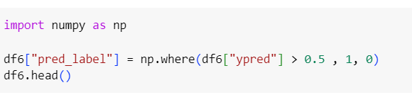
Model comparison – Original VS Predicted Classes
LSTM Classes
BI LSTM Classes
GRU Classes
Original data classes
Classification threshold = 0.5

Slide 18
Champion Model : GRU
Original data Helpfulness distribution
GRU Model Helpfulness distribution
After comparing all the three Models LSTM, BiLSTM and GRU models, we can conclude that the GRU Model is the closest to classifying the original Helpfulness of the target class at 89:11% VS 81:19% as seen in the original data target class distribution.

Slide 19

Questions?

Slide 20
Thank you!

